Slide 1
WELCOME
Presentation
CSE365
ARTIFICIAL INTELLIGENCE
Sec:03
1

Slide 2
Presented by
Md. Ruhel Talukder
ID:2015-1-60-013
Md. Fatin Istiaq
ID:2015-1-60-044

Slide 3
chatbot
EWU Admission Help Zone

Slide 4
What is Chatbot?
Definition :A chatbot (also known as a talkbot, chatterbot, Bot, IM bot, interactive agent, or Artificial Conversational Entity) is a computer program which conducts a conversation via auditory or textual methods

Slide 5
Our Goal
Establishing a chatbot that can help student to get information about EWU.

Slide 6
limitation
Can not reply irrelevant question answer
User need to remove the previous message to chat again
User can not use Bangla language
Can not answer all type of question
Need different software to run the code which is unrealistic
Web based

Slide 7
Chatbot weakness
The disadvantages of chatbots compared with humans stem from their lack of genuine understanding:
Minimal control over response quality (though better than self-completion).
No ability to assess whether unasked questions have already been implicitly answered earlier in the dialogue (relevance).

Slide 8
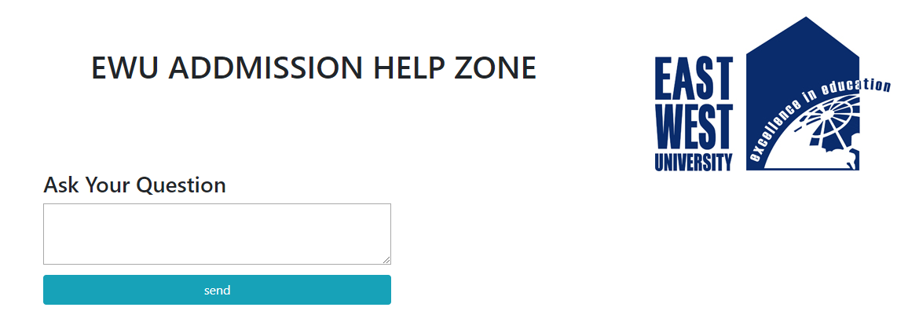
Demo

Slide 9
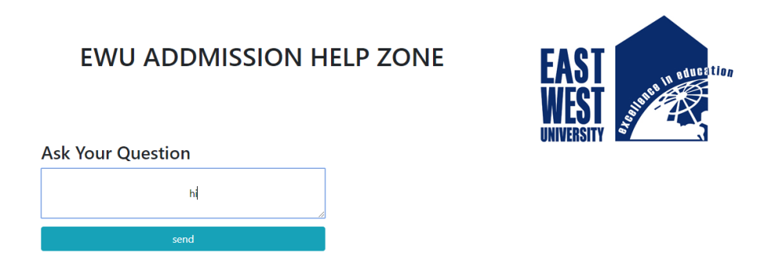
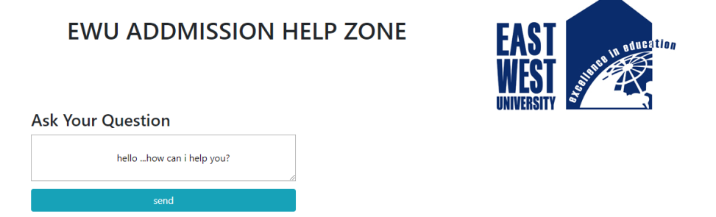
continue

Slide 10
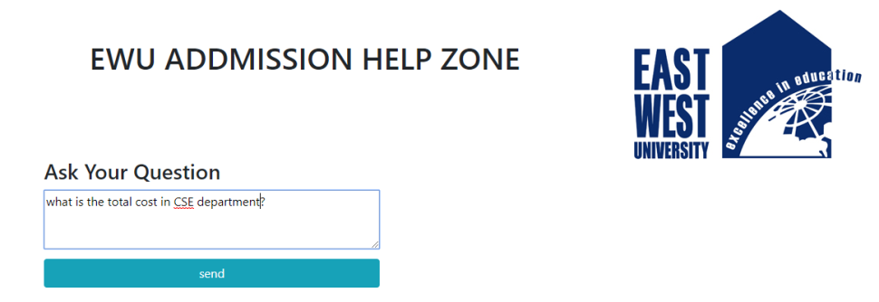
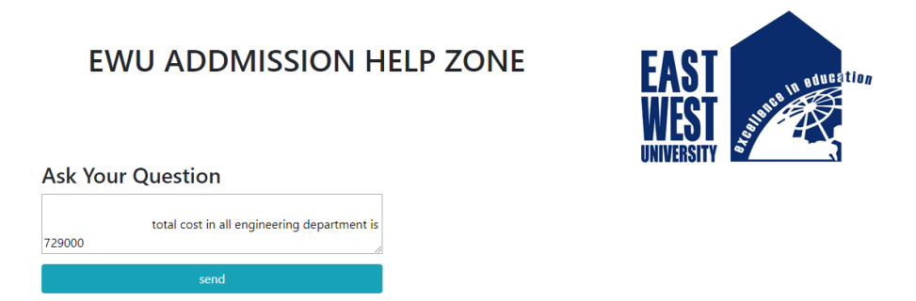
continue

Slide 11
Conclusion

